Slide 1










L-14
Types of inversions and wind velocity profile
Air Pollution and Control (Elective- I)
4

Slide 2

Temperature Inversion
A temperature inversion is when a layer of warmer air covers the colder air at ground level.
4

Slide 3
Temperature Inversion
It forms when the ground level air is kept cold by the cold ground.
Then a warm air mass comes from another area and covers the cold air.
The inversion acts like a lid over the cold ground level air
4

Slide 4
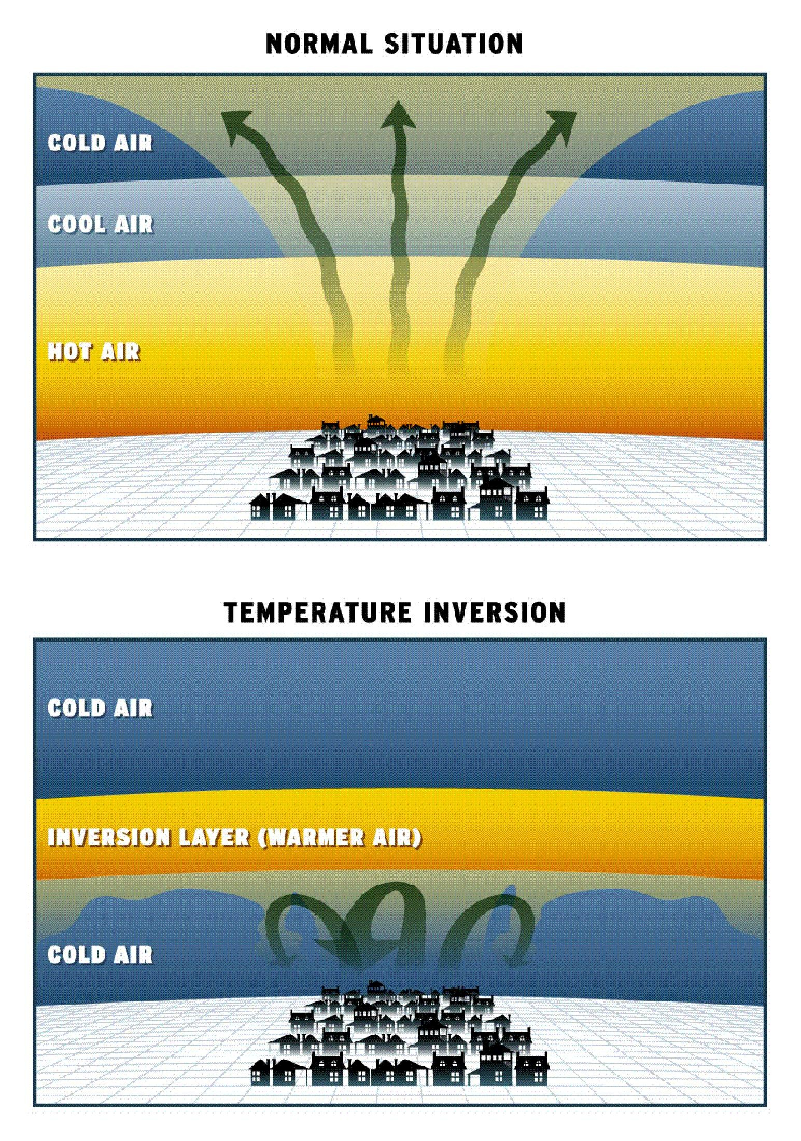
4

Slide 5
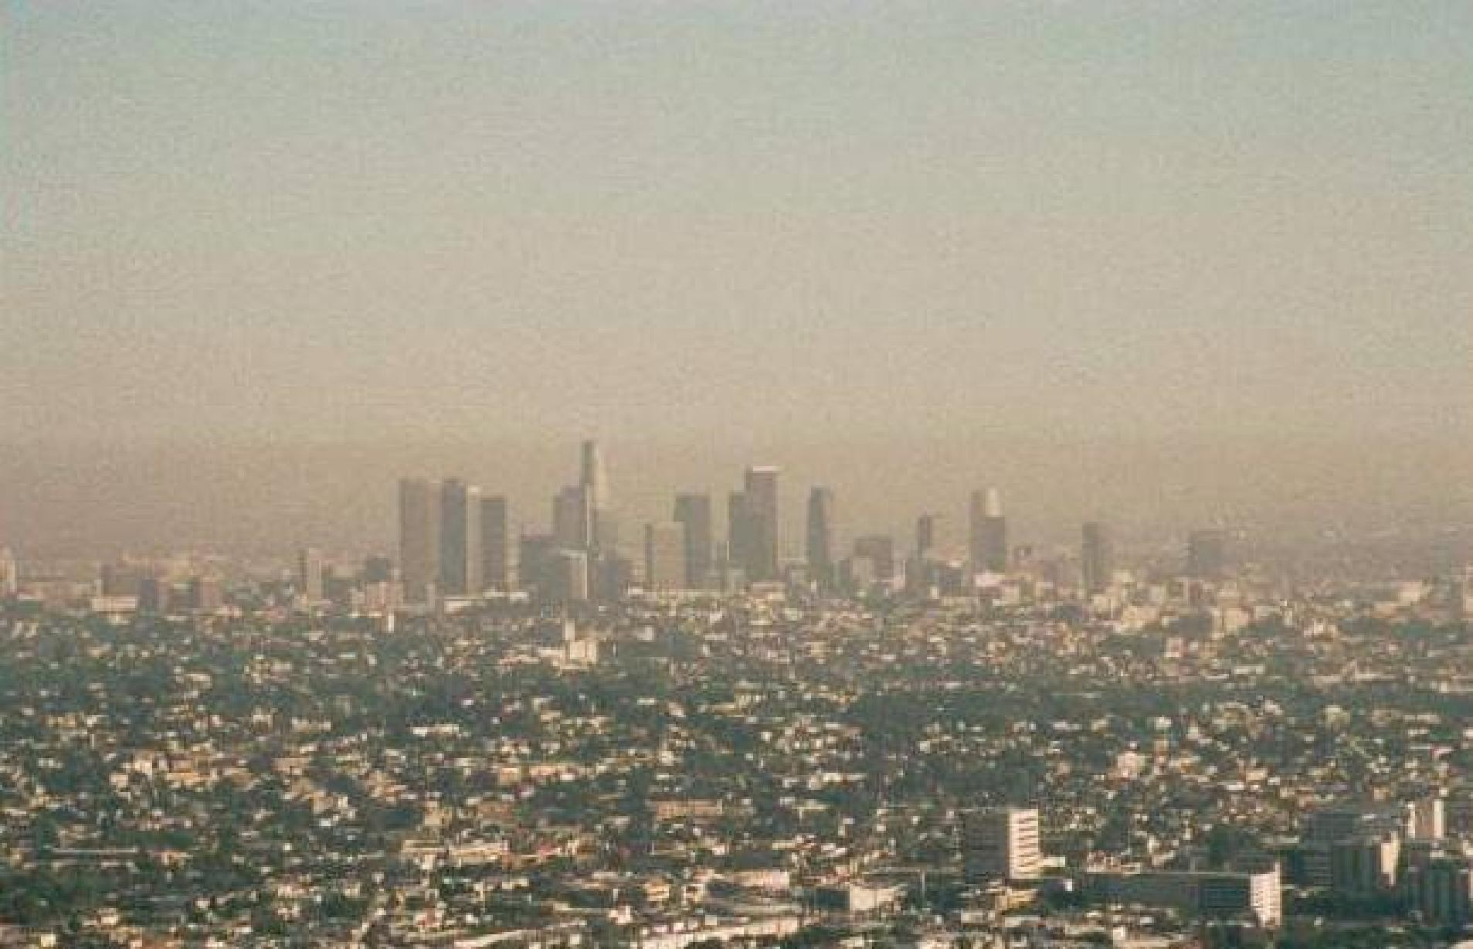
The Air Gets Dirty!
4

Slide 6
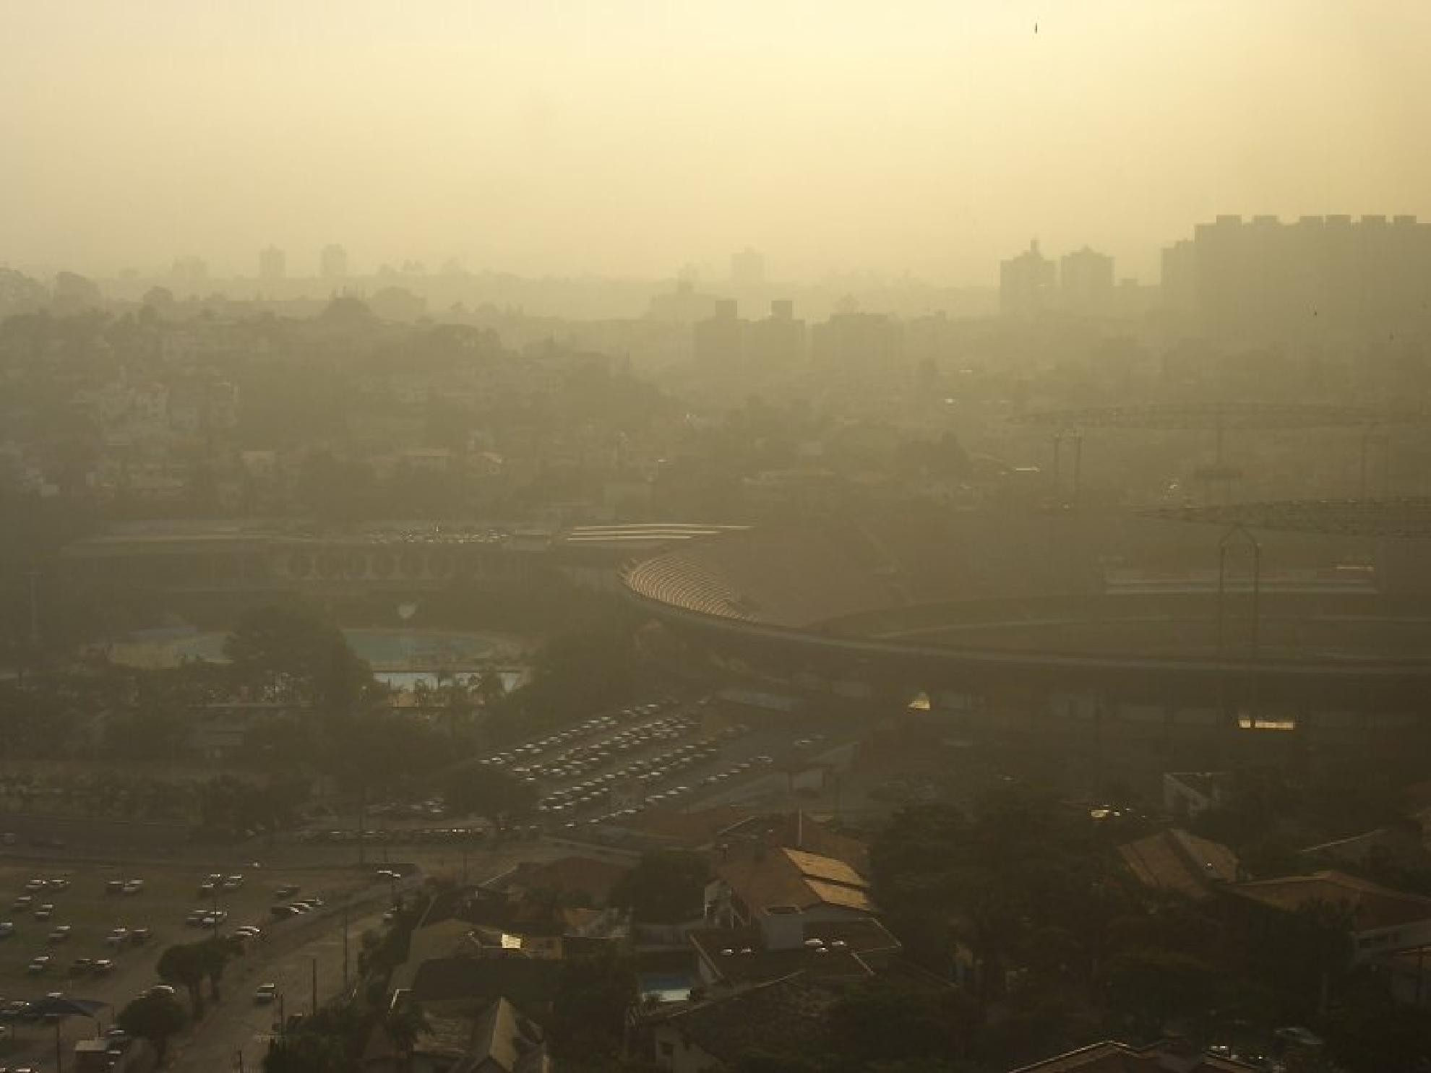
Real Dirty!
4

Slide 7

Temperature Inversion
4

Slide 8
Inversion
Inversion is defined as increase in temperature with respect to altitude. It is also known as negative lapse rate.
Two major types of inversion:
  Subsidence Inversion
  Radiation Inversion
  Combination of subsidence and radiation
Prof S S Jahag8irdar, NKOCET

Slide 9
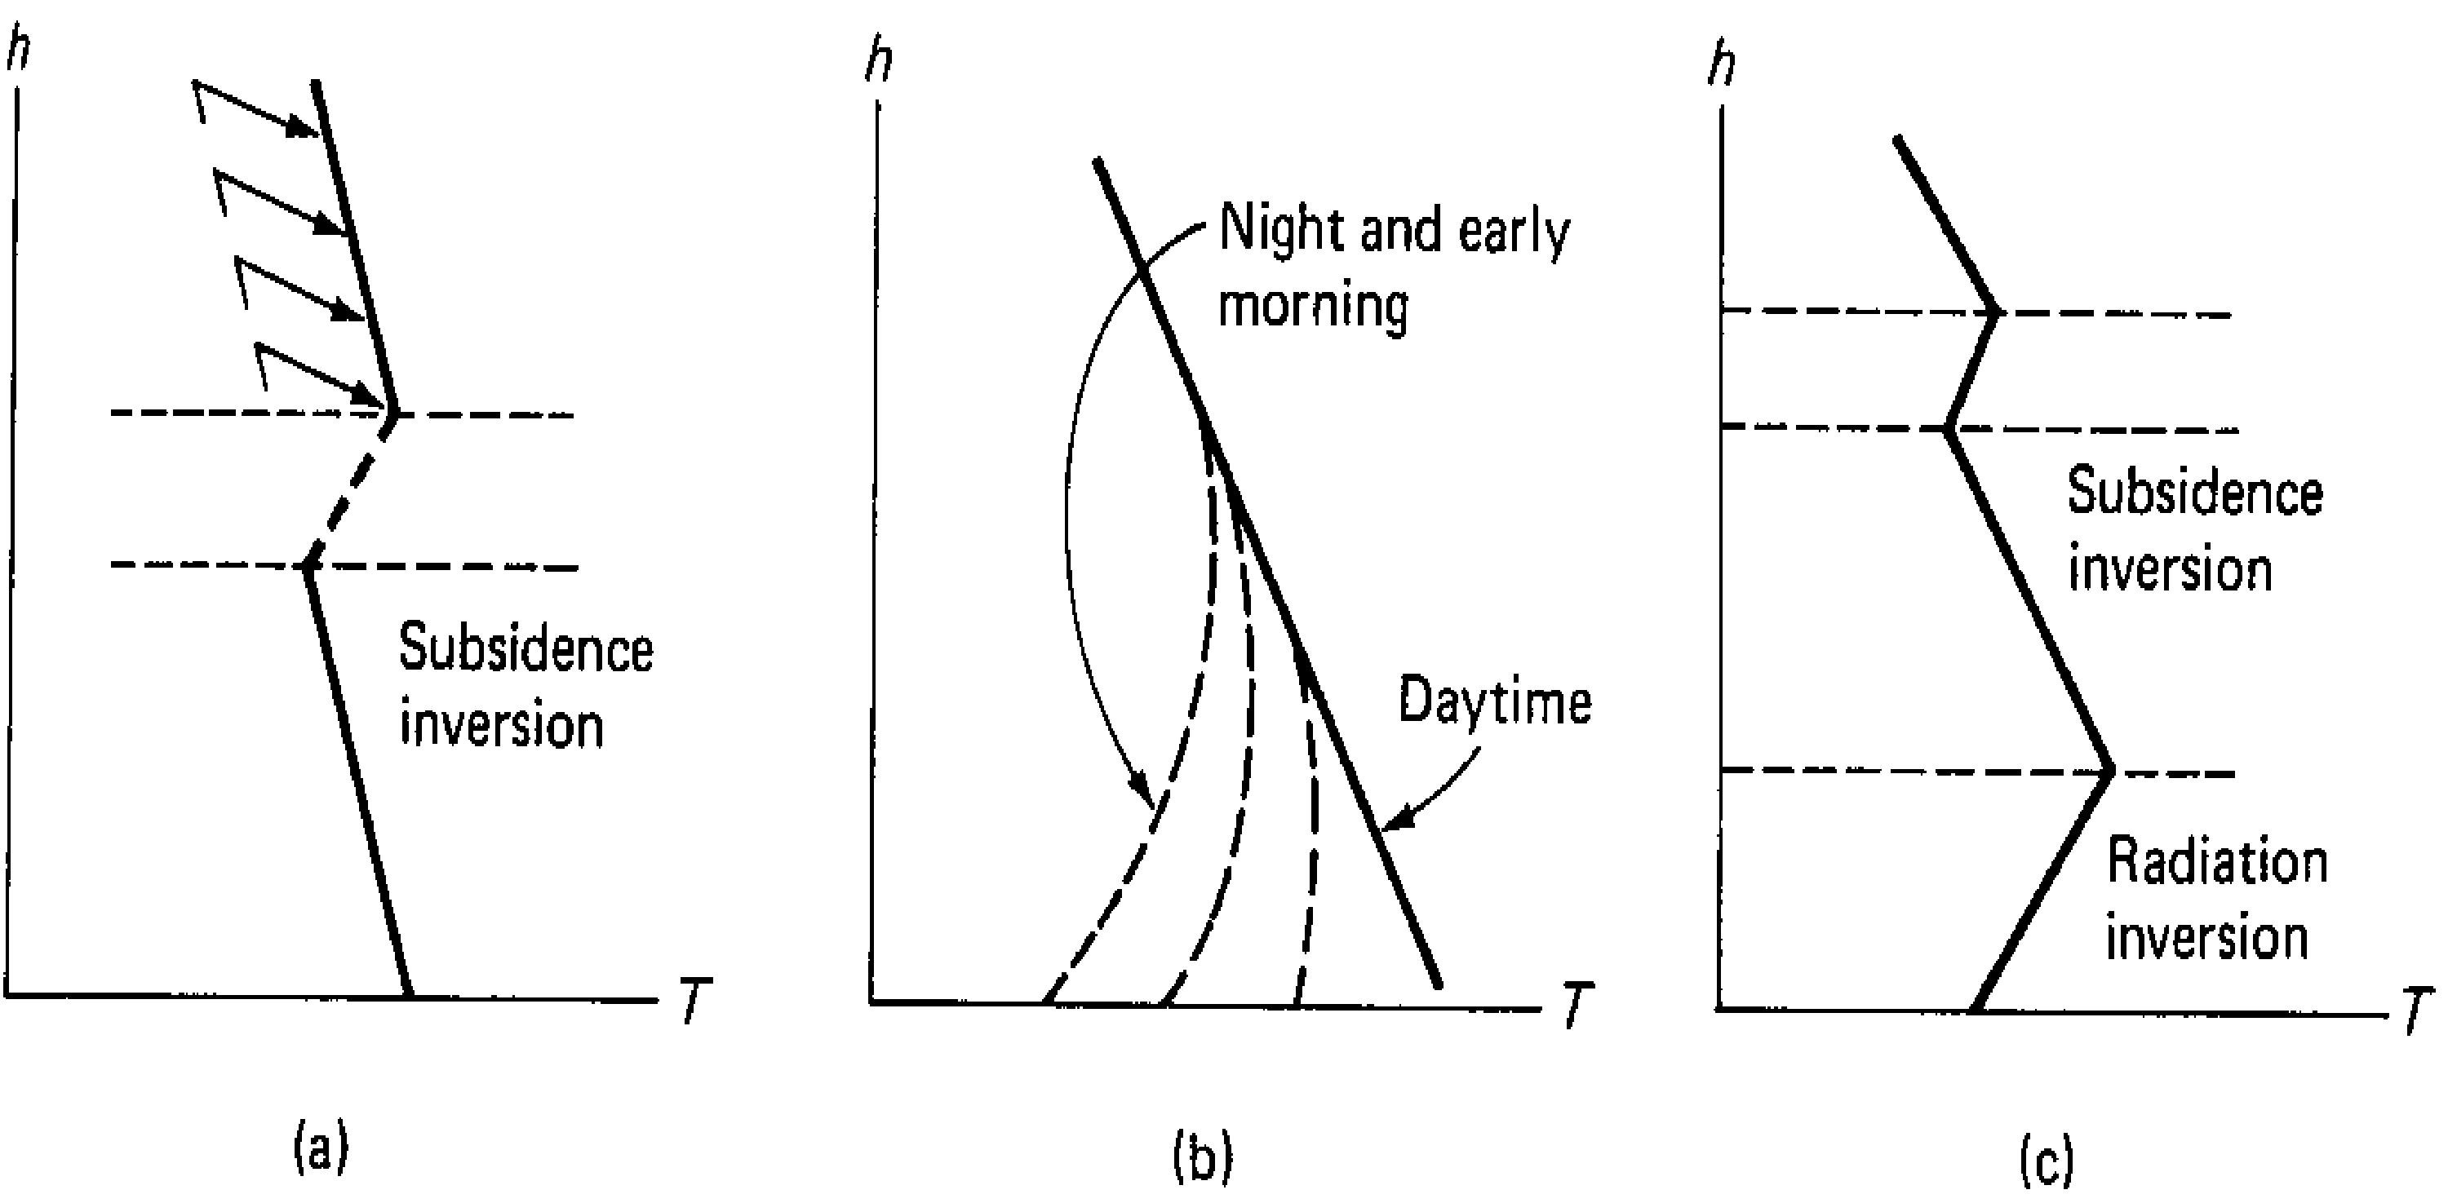
3. Combination of radiation and Subsidence inversion
1. Subsidence inversion
2. Radiation inversion
Prof S S Jahagirdar, NKOCET
9

Slide 10
1. Subsidence Inversion
Occurs high above emission sources.
Associated with high-pressure systems
Inversion layer is formed aloft
Covers hundreds of thousands of square kms
contribute to long term air pollution problems.
Persists for several days and greatly contribute to long term accumulation of pollutants.
Gets broken by strong winds at that altitude.
Prof S S Jahagirdar, NKOCE1T0

Slide 11
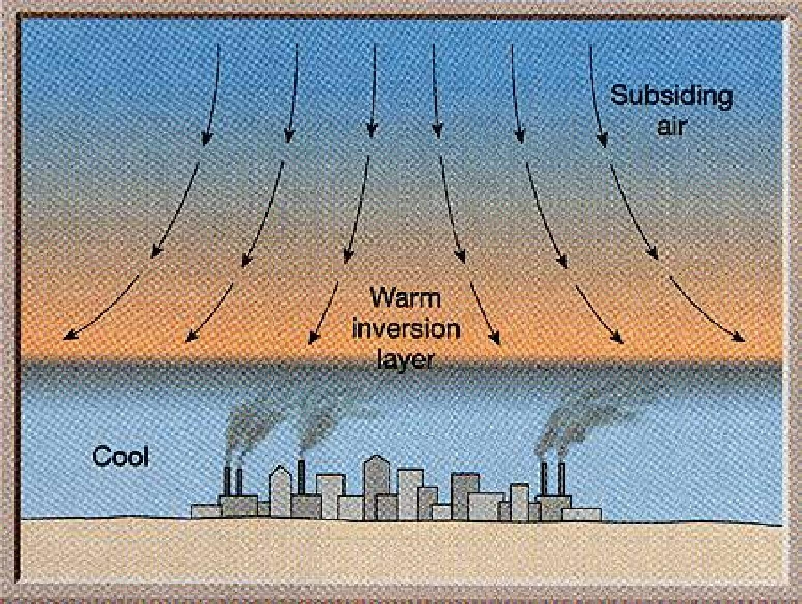
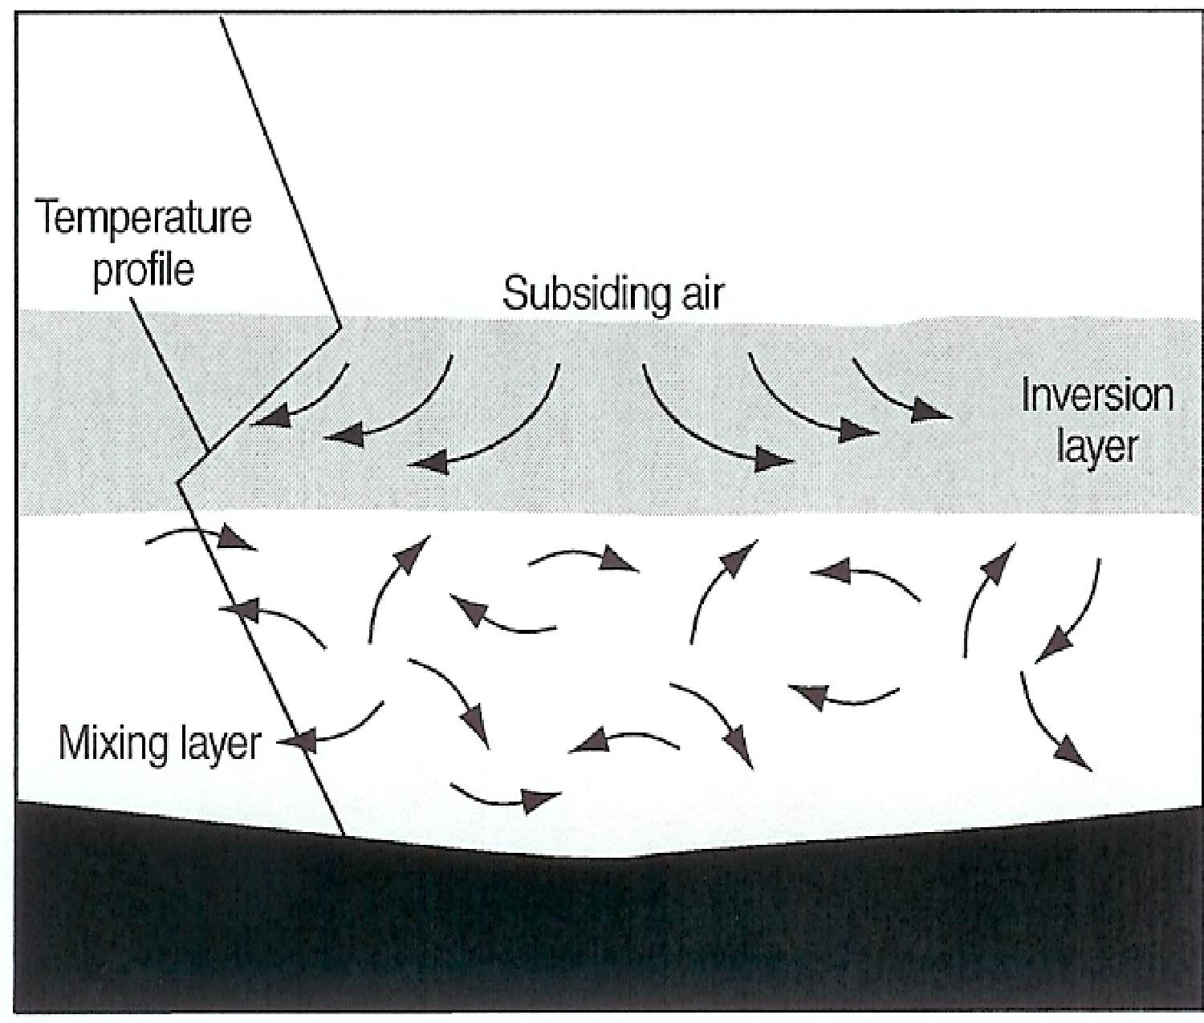
Elevation of base of inversion varies from about 200m to around 1000m.

Slide 12
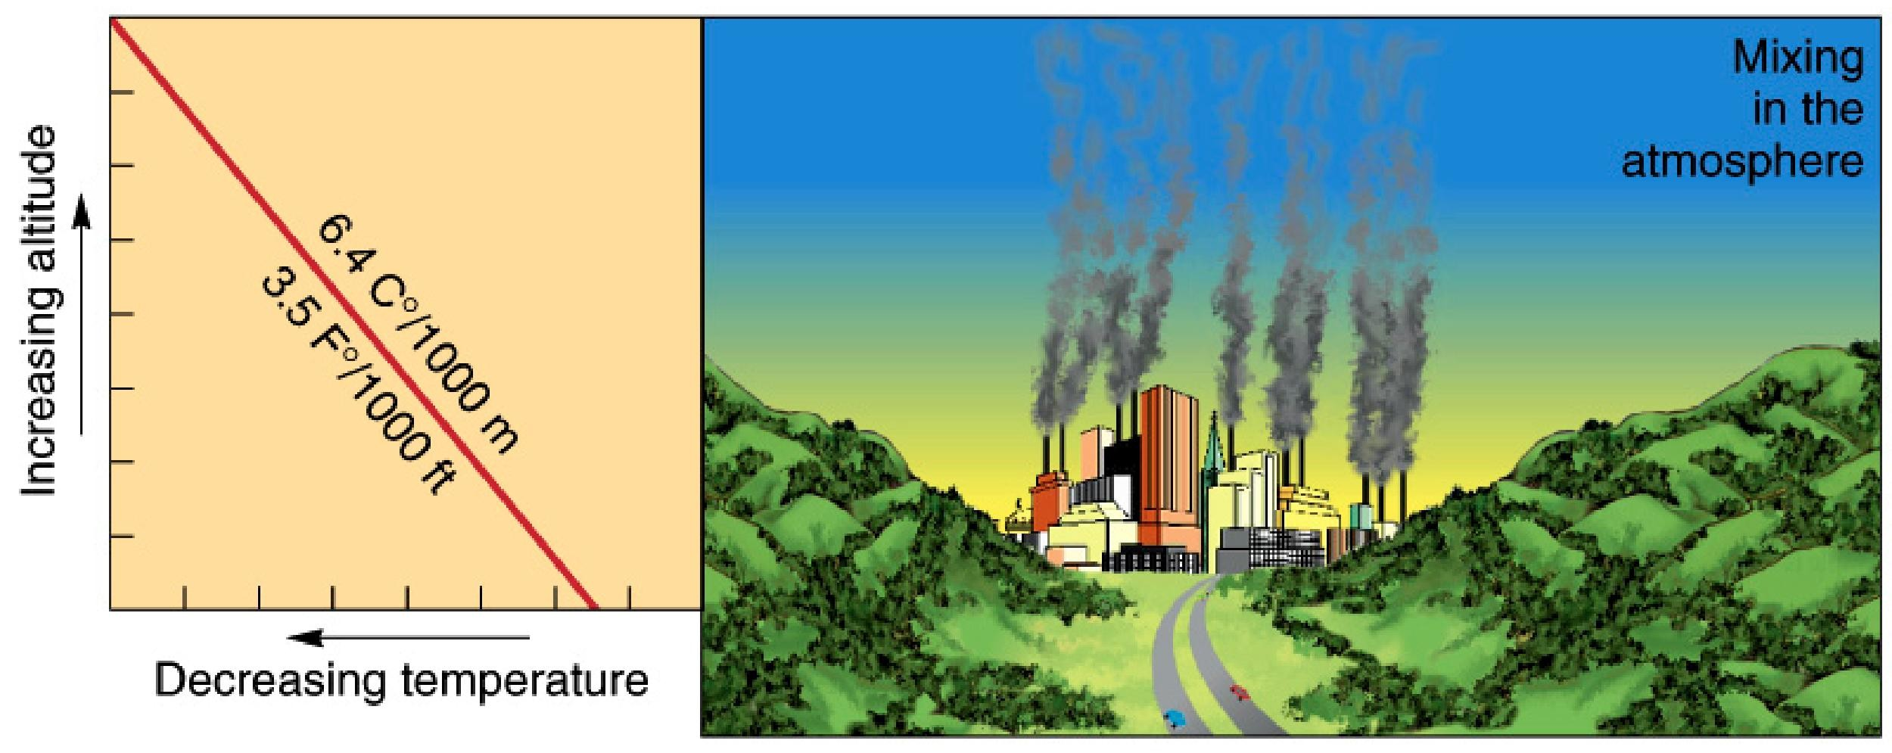
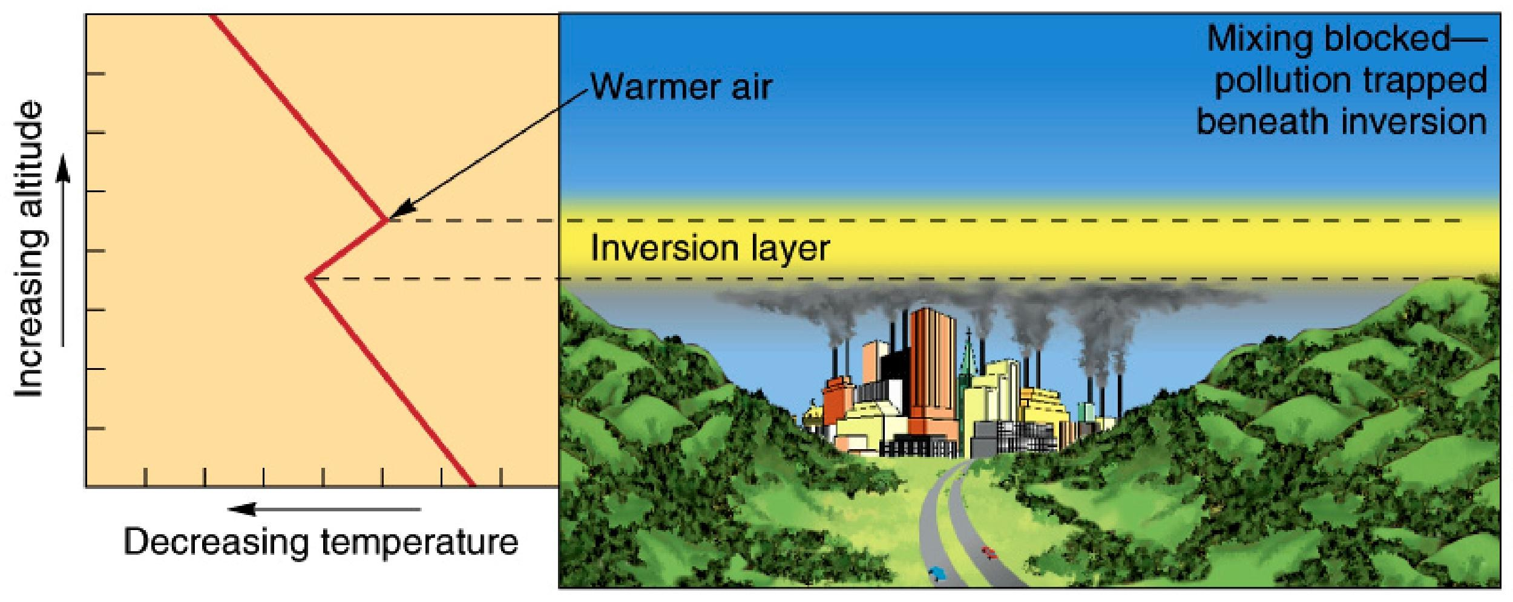
UNSTABLE
STABLE

Slide 13
2. Radiation Inversions
Surface layers of the atmosphere during the day receive heat by conduction, convection and radiation from the earth’s surface and are warmed.
This results in temperature profile in the lower atmosphere that is represented by a negative lapse rate.
These types of inversions are intensified in river valleys.
Cause pollutants to be “trapped”.
Prof S S Jaha1g3irdar, NKOCET

Slide 14
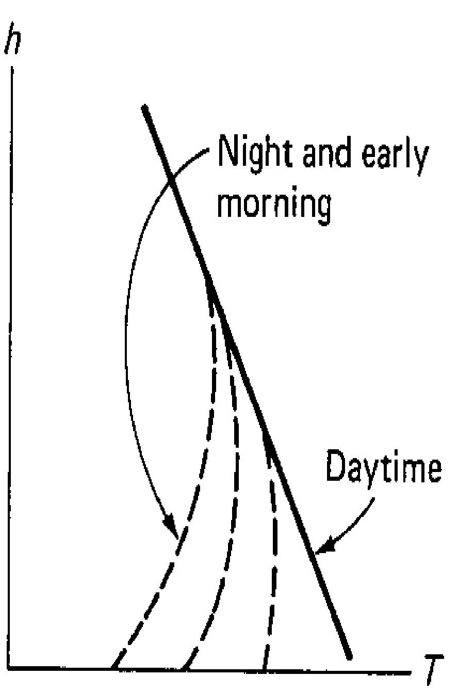
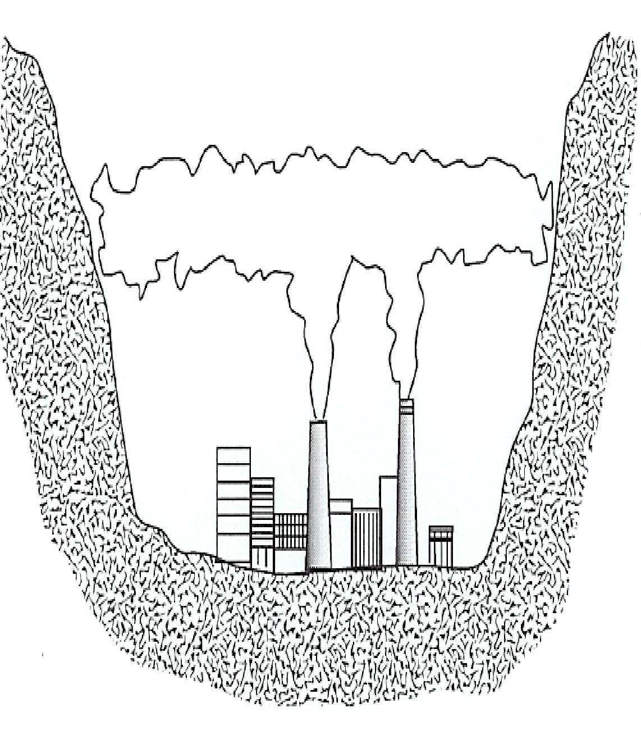
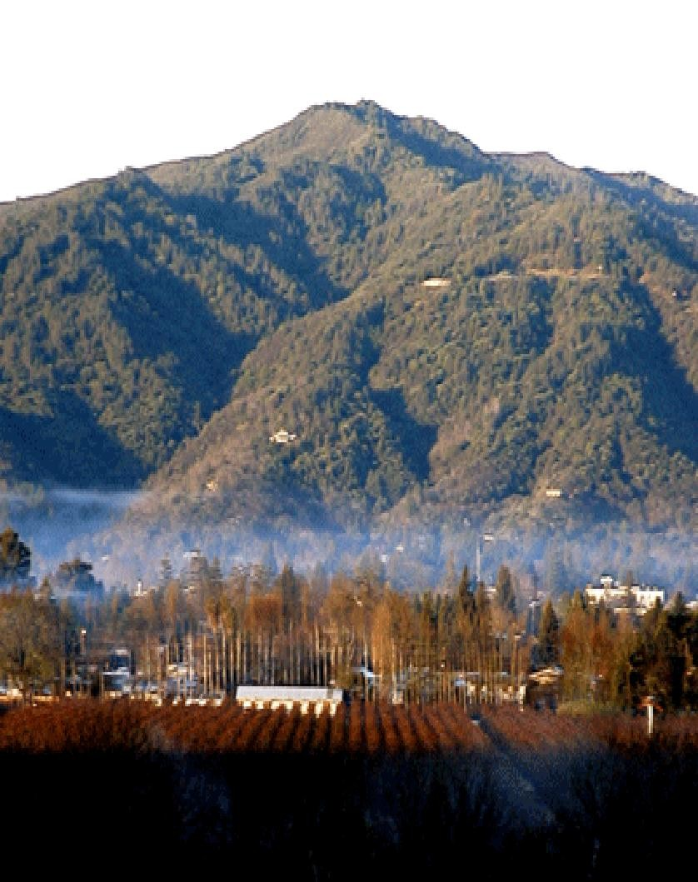
Prof S S Jahagirdar, NKOCET
14

Slide 15
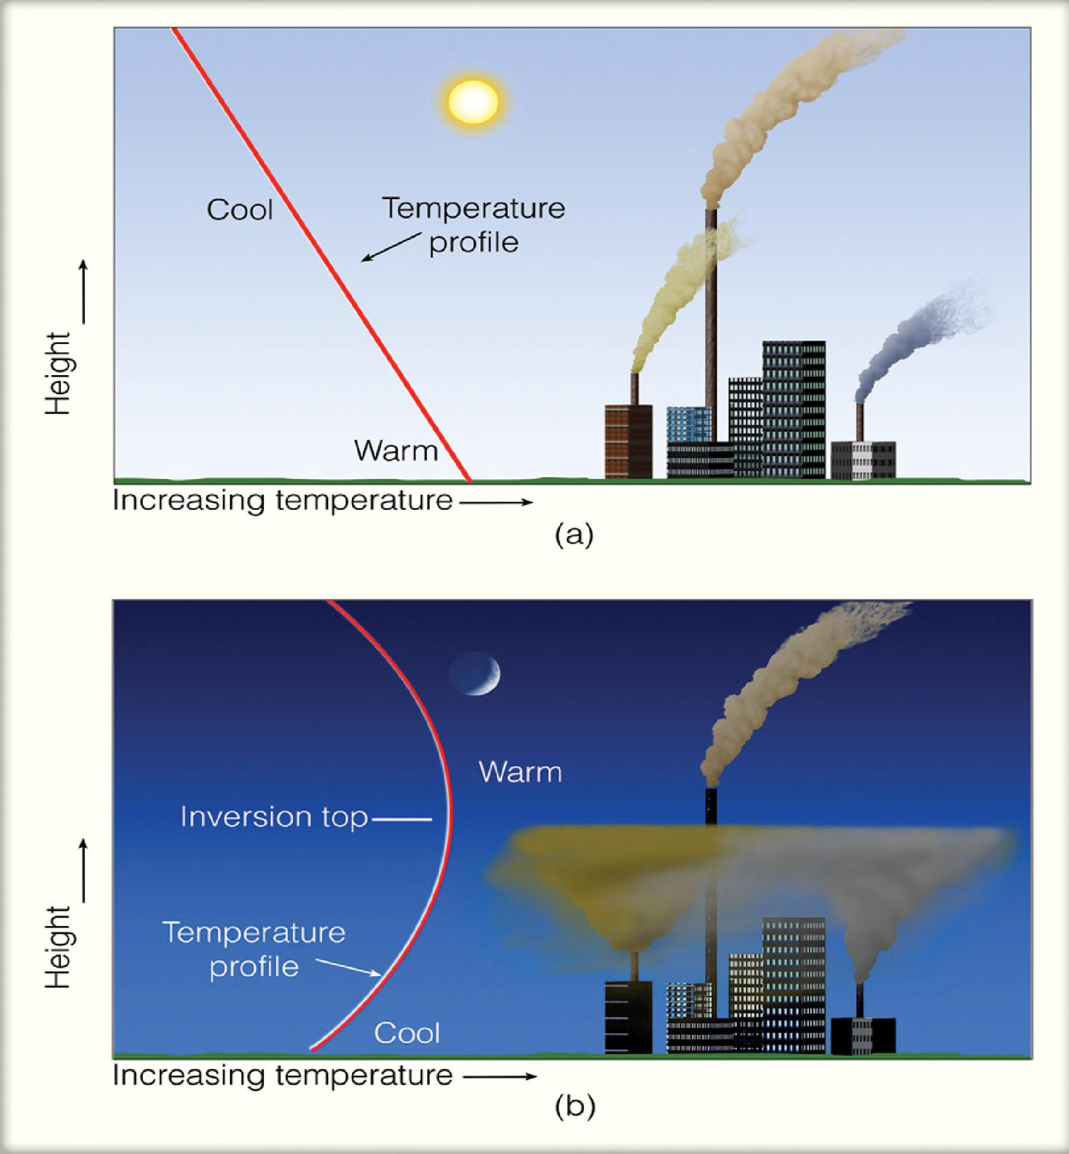
Breakup after sunrise.
Occurs in winter season in India.
Most likely to occur during windless and cloudless nights.
Prof
S S Jaha15girdar, NKOCET

Slide 16
3. Combination of radiation and Subsidence inversion
It is possible for subsidence and radiation inversions to appear in the atmosphere at the same time.
Joint occurrence of these two types of inversions leads to a special phenomena called ‘Trapping of plume’.

Slide 17
WIND VELOCITY PROFILE

Slide 18
Wind Velocity Profile
Friction retards wind movement
Friction is proportional to surface roughness
Location and size of surface objects produce different wind velocity gradients in the vertical direction
Area of atmosphere influenced by friction – few hundred m to several km above earth’s surface

Slide 19
Wind Velocity Profile
Wind speed varies by height
International standard height for wind-speed measurements is 10 m
Dispersion of pollutant is a function of wind speed at the height where pollution is emitted
But difficult to develop relationship between height and wind speed

Slide 20
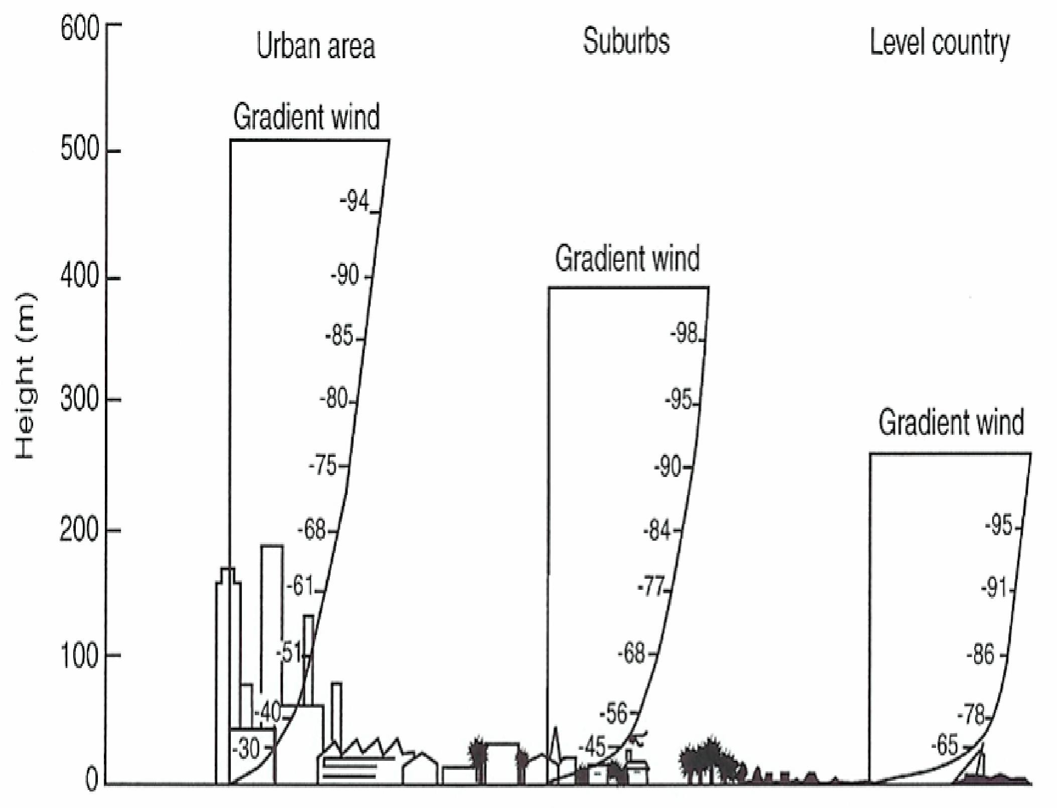
Wind
Maximum height of wind profiles indicate where effects of surface roughness end and where gradient wind begins
Fig 3.1
Prof S S Jaha2g0irdar, NKOCET

Slide 21
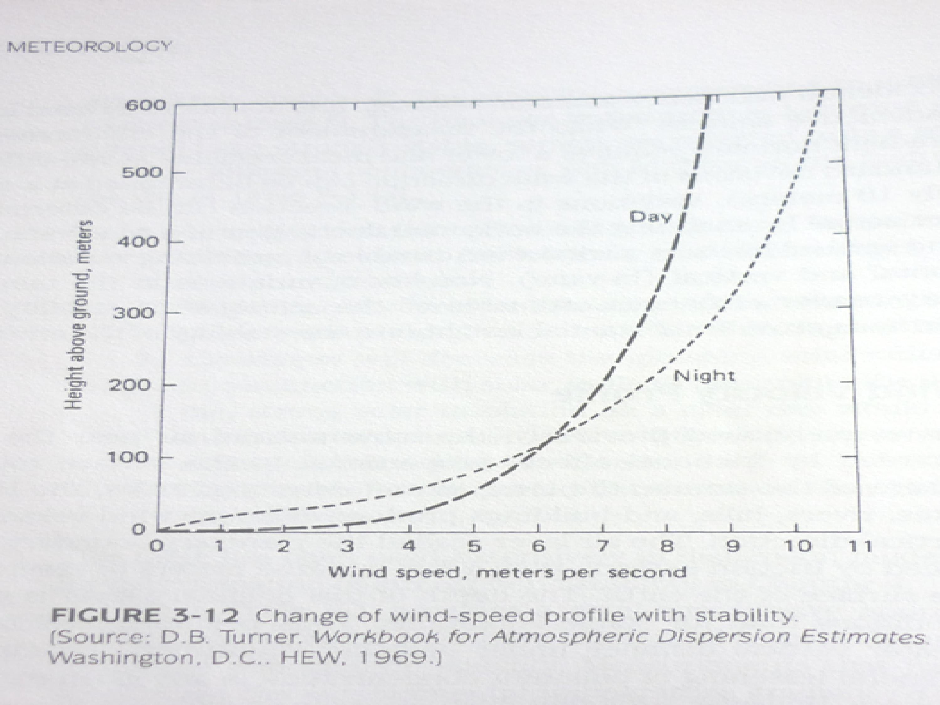

Prof S S Jahagirdar, NKOCET 21

Slide 22
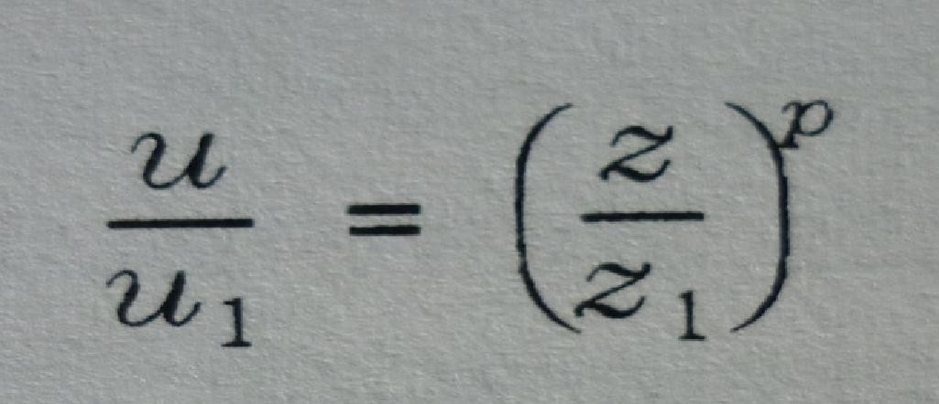
Calculating Effective Stack Height Wind
Speed: Deacons’ power law
The surface wind speed is different at the effective stack height, which is used in the Gaussian model. At elevation z1, wind speed u₁ is given by the following equation and table.
Where:
u = wind speed at altitude z, m/s
z₁ = effective stack height or altitude at which wind speed is needed, m
z= height above surface at which wind speed is measured, m (usually 10 meters)
p = exponent is a function of atmospheric stability class
22

Slide 23
Value of p for Deacons power
law irrespective of type of terrain
p

Slide 24
Problems

Slide 25
1. The wind speed at 10 m altitude is 5m/s. Find the wind speed at 250 m altitude for the following stability conditions.
Large lapse rate
Zero or small lapse rate
Moderate inversion
Large inversion

Slide 26
2. Wind speed at 10 m altitude is 2m/s. Find the wind speed at 200 m altitude for following cases
Large lapse rate
Zero lapse rate
Moderate inversion
Large inversion

Slide 27
3. The ground level wind velocity at 10 m elevation is 5.2 m/sec in a city. What would you estimate the velocity to be at 125m elevation in moderately stable atmosphere?

Slide 28
Objective Questions
Q1. Radiation inversion gets broken by
.
Q2. Subsidence inversion persist for
.
Q3. As per Deacon’s power law, Wind speed at any height is given by .
Q4. Stability class refers to neutral stability condition.
Q5. stability class refers to most unstable condition.
Q6. . stability class refers to most stable
condition.
Prof S S Jahagirdar, NKOCET 28

Slide 29
Q7. In Deacons law value of exponent p in rough terrain, for neutral stability condition is
. (similar objective questions for all values).
Q8. An _ _ acts as a lid on vertical air movement.
Q9. When the earth's surface cools rapidly, such as between late night and early morning under clear skies, a _
inversion is likely to occur.

Slide 30
Theory Questions
Q1. Discuss in detail three types of inversions with neat sketches.
Q2. What is power law of Deacon? What is its use?

Slide 31
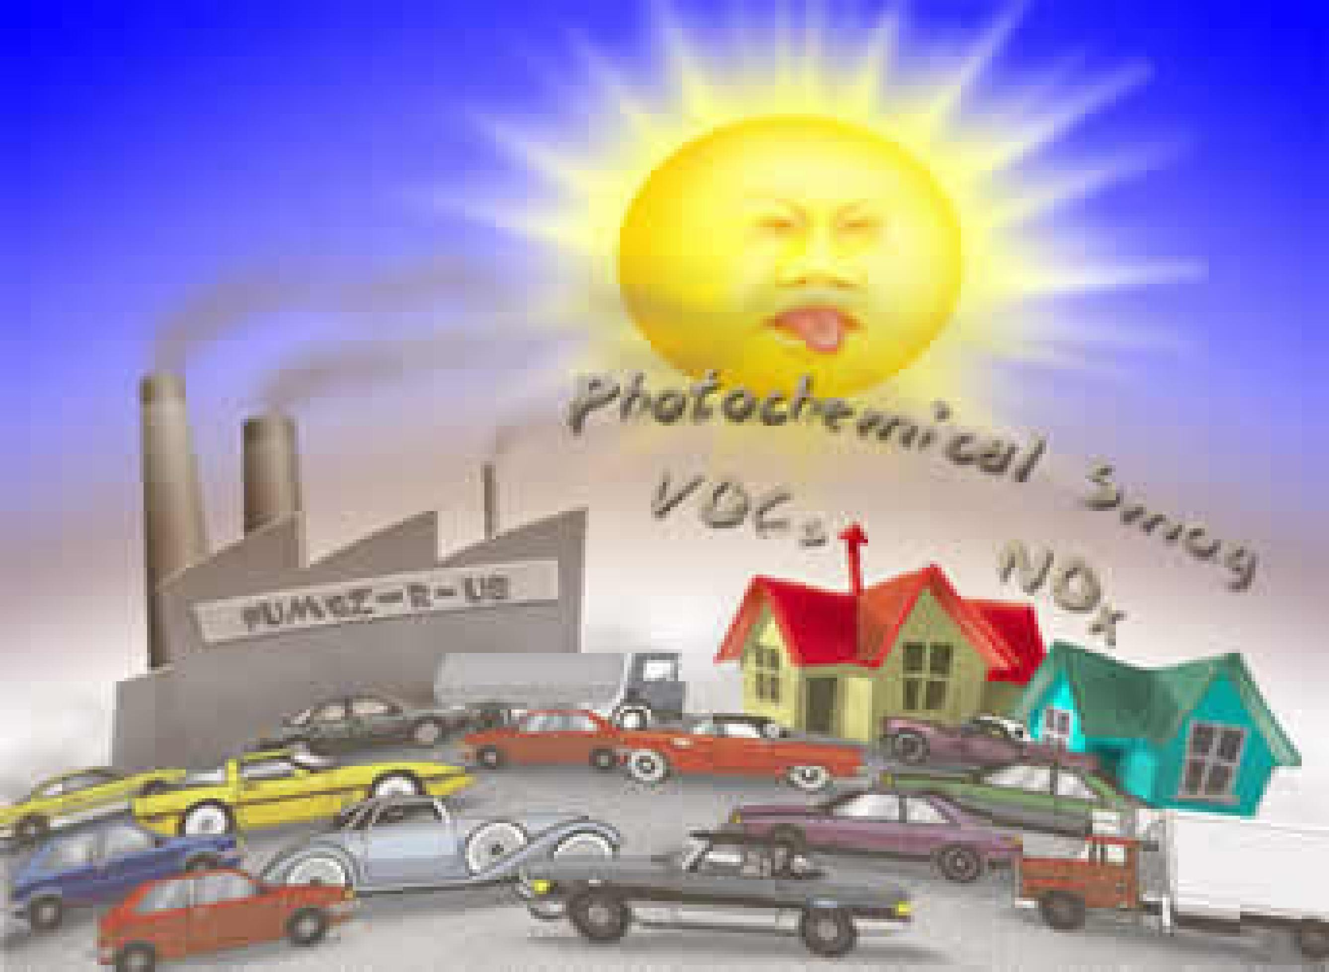
Summer Inversion

Slide 32
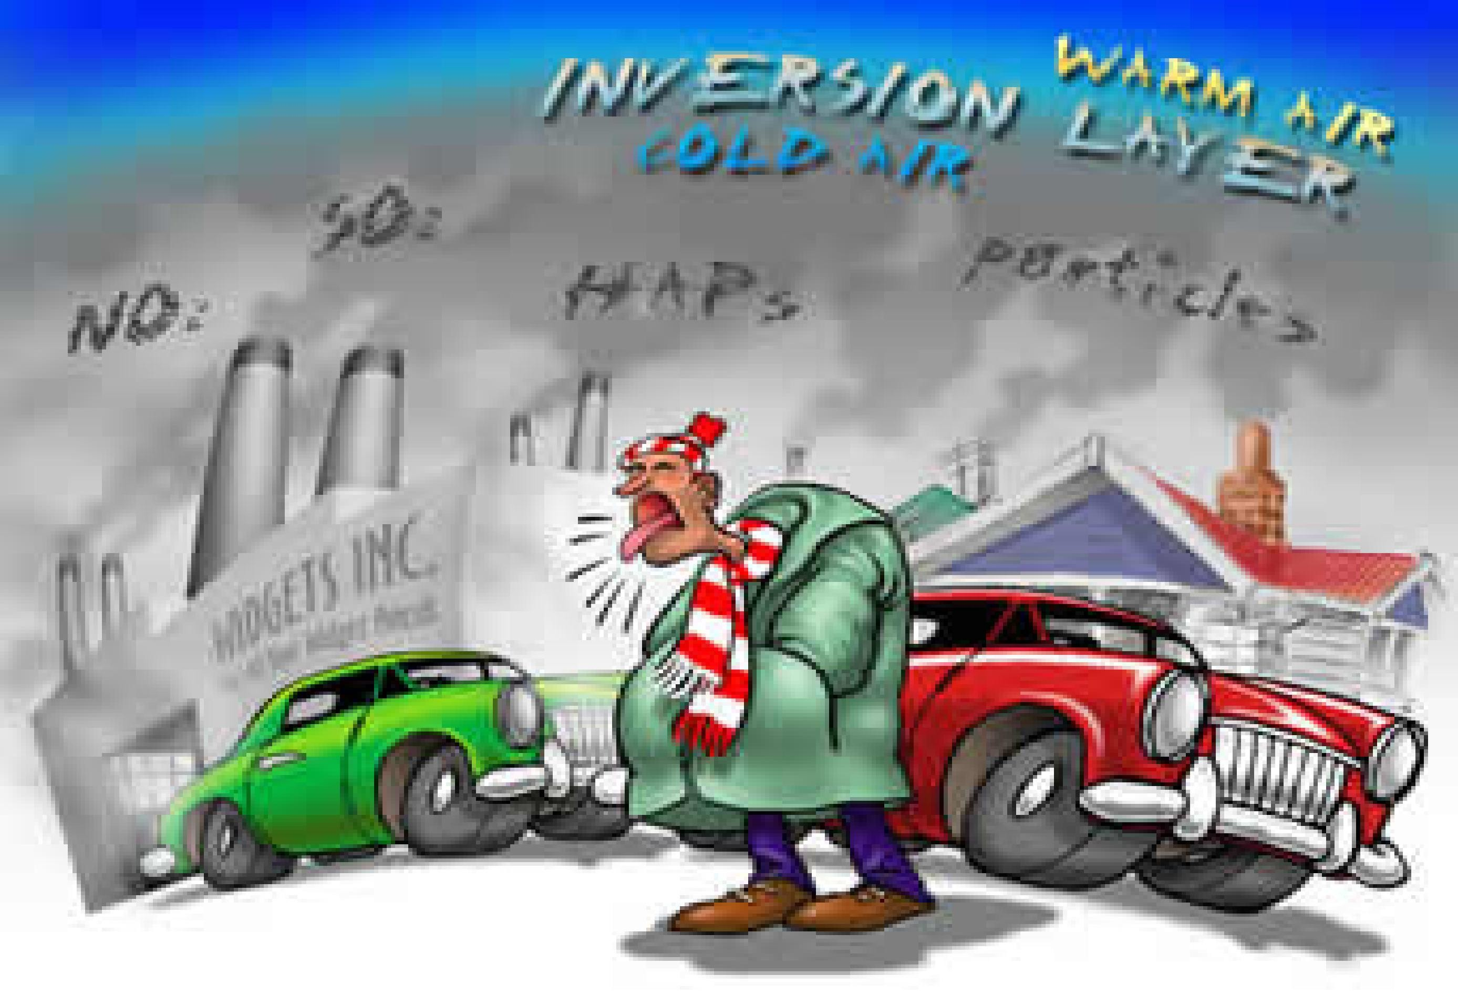
Winter Inversion

